Slide 1
Brownian motion in stocks

Slide 2
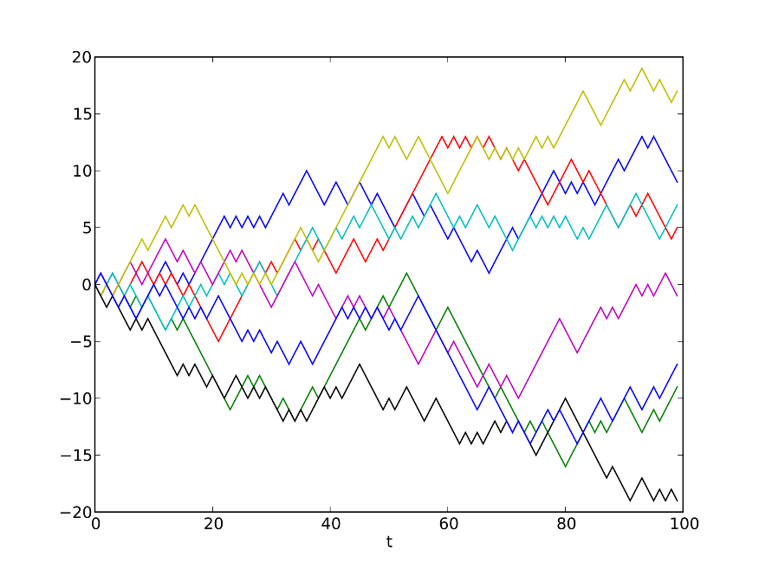
Random walk

Slide 3
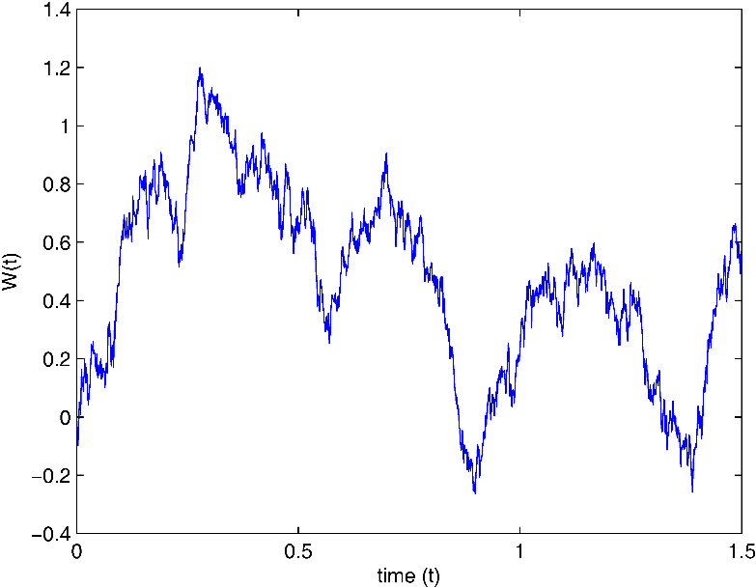
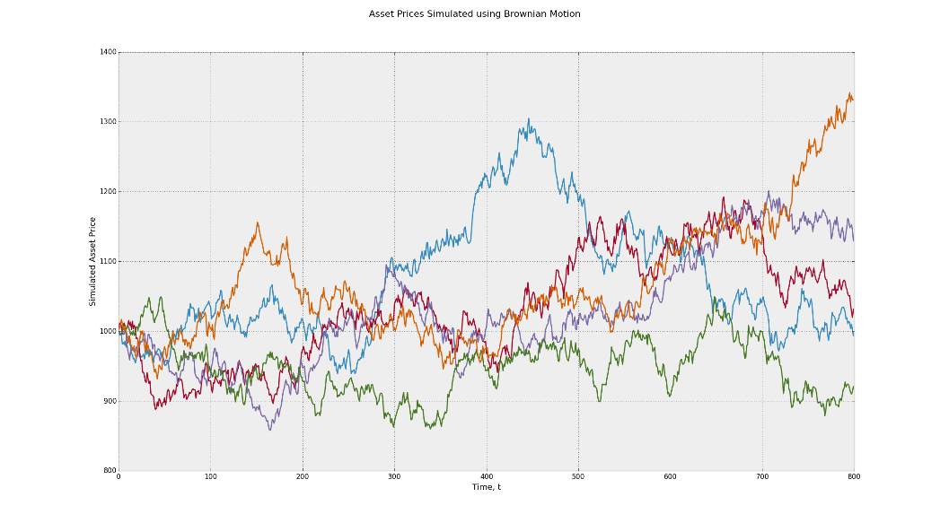
Brownian motion

Slide 4
Naïve mode for stock price
P_{t} = P_{t-1} + N(0,σ)
D_{t} = floor(P_{t})
We see only D_{t}’s
Want to estimate Ε(P_{t} | D_{1:t})

Slide 5
example
P_{t} = P_{t-1} + N(0,0.1)
See 103,103,104. what is the mean?
103,103,104,104,……..,104. what is the mean

Slide 6
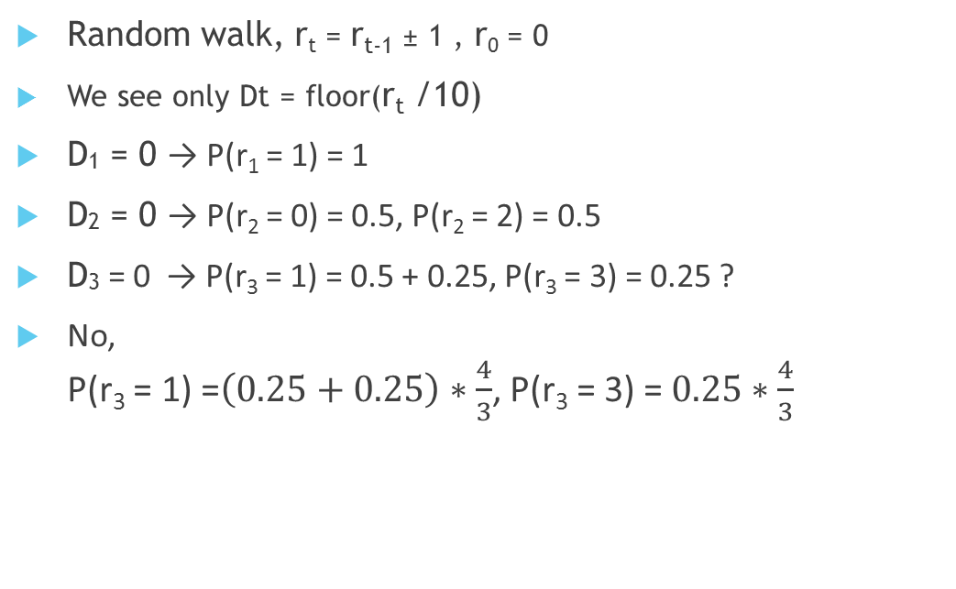
Another example
Random walk, r_{t} = r_{t-1} ± 1 , r₀ = 0
We see only Dt = floor(r_{t} /10)
D₁ = 0 → P(r₁ = 1) = 1
D₂ = 0 → P(r₂ = 0) = 0.5, P(r₂ = 2) = 0.5
D₃ = 0 → P(r₃ = 1) = 0.5 + 0.25, P(r₃ = 3) = 0.25 ?
No, P(r₃ = 1) =$\left(0.25+0.25\right)∗\frac{4}{3}$, P(r₃ = 3) = $0.25∗\frac{4}{3}$

Slide 7
First suggestion
Use Ε(P_{t-1} | D_{1:t-1}) to simply calculate Ε(P_{t} | D_{1:t})
Not enough information, need to have knowledge on P(P_{t-1} | D_{1:t-1})
Use sampling

Slide 8
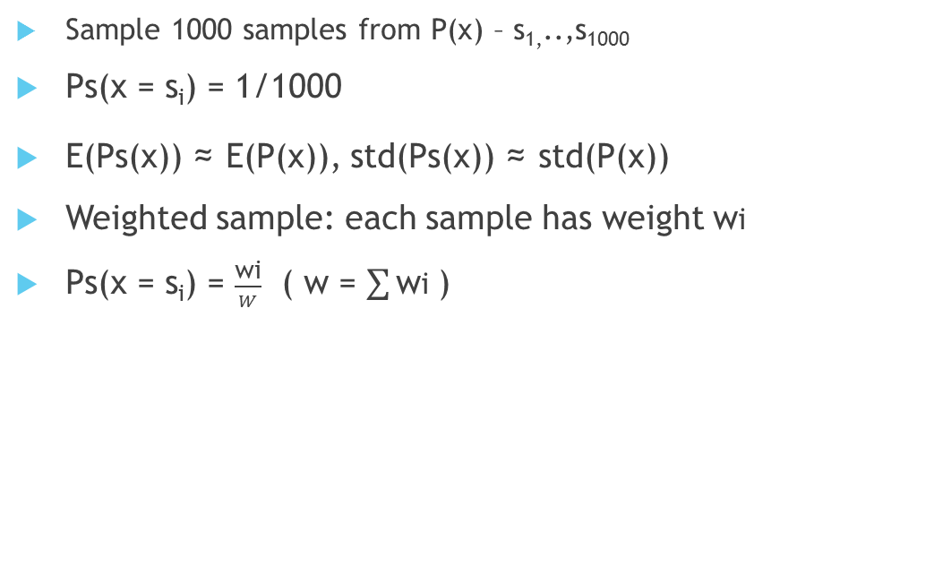
Sampling
Sample 1000 samples from P(x) – s_{1,}..,s₁₀₀₀
Ps(x = s_{i}) = 1/1000
E(Ps(x)) ≈ E(P(x)), std(Ps(x)) ≈ std(P(x))
Weighted sample: each sample has weight wi
Ps(x = s_{i}) = $\frac{\text{wi}}{W}$ ( w = $\sum{\text{w}\text{i} }$)

Slide 9
Sampling
We have P(x) ∝ P₁(x)P₂(x)
Know how to sample from P₁(x)
How do we sample?

Slide 10
Importance sampling
Want to sample 1000 samples from probability P₁ ₌ N(0,1)
We have 1000 samples from P₂ = N(1,1)
Give each sample weight P₁/P₂
Do it when we don’t know how to sample from the original distribution

Slide 11
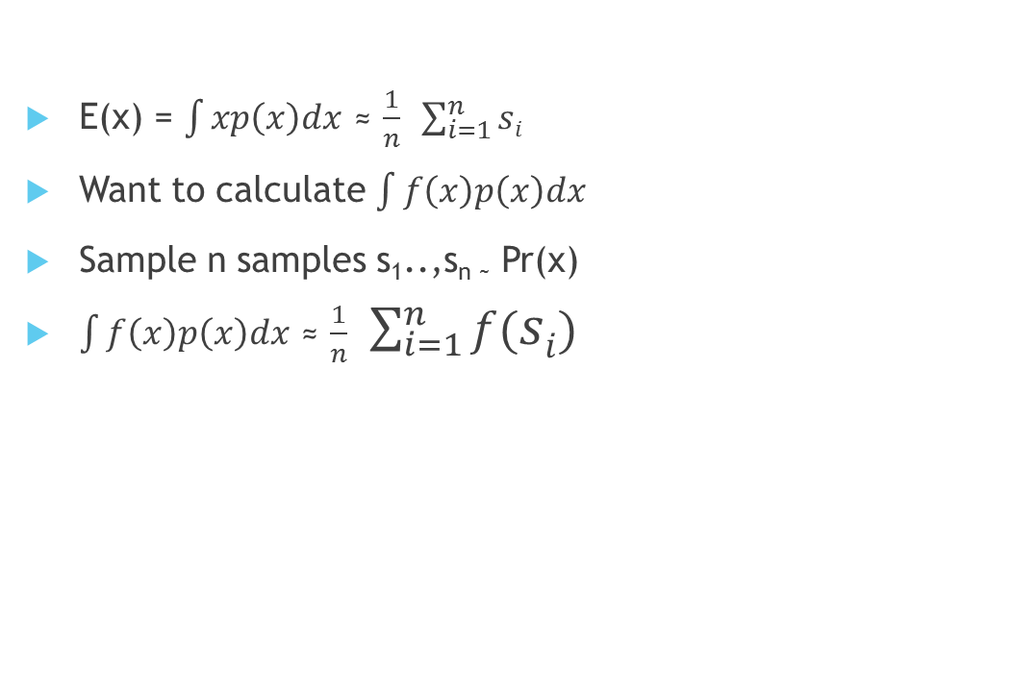
Estimate integral with sampling
E(x) = $\int{xp\left(x\right)dx}$ ≈ $\frac{1}{n}$ $\sum_{i=1}^{n}{si}$
Want to calculate $\int{f\left(x\right)p\left(x\right)dx}$
Sample n samples s₁..,s_{n ~} Pr(x)
$\int{f\left(x\right)p\left(x\right)dx}$ ≈ $\frac{1}{n}$ $\sum_{i=1}^{n}{f(si})$

Slide 12
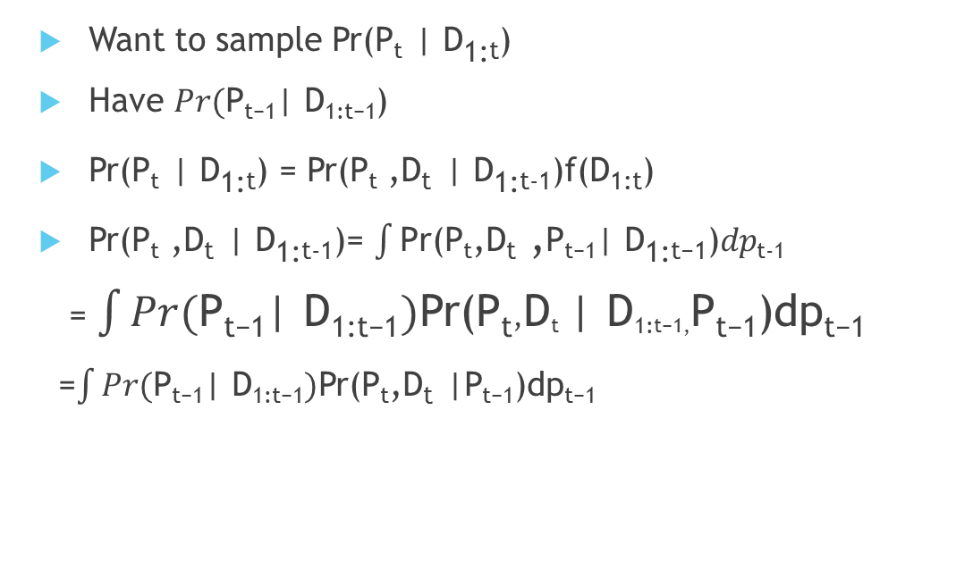
Sample stock price
Want to sample Pr(P_{t} | D_{1:t})
Have $Pr(\text{P}\text{t}\text{−}\text{1}\text{| }\text{D}\text{1}\text{:}\text{t}\text{−}\text{1}$)
Pr(P_{t} | D_{1:t}) = Pr(P_{t} ,D_{t} | D_{1:t-1})f(D_{1:t})
Pr(P_{t} ,D_{t} | D_{1:t-1})= $\int{\text{P}\text{r}\text{(}\text{Pt}\text{,}\text{D}\text{t} \text{,}\text{P}\text{t}\text{−}\text{1}\text{| }\text{D}\text{1}\text{:}\text{t}\text{−}\text{1}\text{)}dp}$_{t-1}
= $\int{Pr(\text{P}\text{t}\text{−}\text{1}\text{| }\text{D}\text{1}\text{:}\text{t}\text{−}\text{1})\text{P}\text{r}\text{(}\text{P}\text{t}\text{,}\text{D}\text{t} \text{| }\text{D}\text{1}\text{:}\text{t}\text{−}\text{1}\text{,}\text{P}\text{t}\text{−}\text{1}\text{)}\text{dp}\text{t}\text{−}\text{1}}$
=$\int{Pr(\text{P}\text{t}\text{−}\text{1}\text{| }\text{D}\text{1}\text{:}\text{t}\text{−}\text{1})\text{P}\text{r}\text{(}\text{Pt}\text{,}\text{D}\text{t} \text{|}\text{P}\text{t}\text{−}\text{1}\text{)}\text{dp}\text{t}\text{−}\text{1}}$

Slide 13
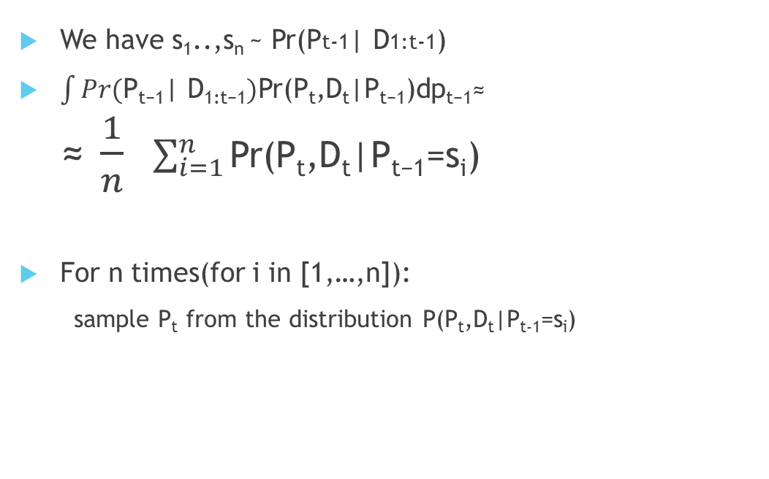
Sample stock price
We have s₁..,s_{n} ~ Pr(Pt-1| D1:t-1)
$\int{Pr(\text{P}\text{t}\text{−}\text{1}\text{| }\text{D}\text{1}\text{:}\text{t}\text{−}\text{1})\text{P}\text{r}\text{(}\text{Pt}\text{,}\text{Dt}\text{|}\text{P}\text{t}\text{−}\text{1}\text{)}\text{dp}\text{t}\text{−}\text{1}}$≈ ≈ $\frac{1}{n}$ $\sum_{i=1}^{n}{\text{P}\text{r}\text{(}\text{Pt}\text{,}\text{Dt}\text{|}\text{P}\text{t}\text{−}\text{1}\text{=}\text{si}\text{)}}$
For n times(for i in [1,…,n]):
sample P_{t} from the distribution P(P_{t},D_{t}|P_{t-1}=s_{i})

Slide 14
Sample stock price
Pr(P_{t},D_{t}|P_{t-1}) = Pr(P_{t}|P_{t-1}) Pr(D_{t}|P_{t},P_{t-1})
Pr(D_{t}|P_{t},P_{t-1}) = Pr(D_{t}|P_{t})
Sample P_{t} from Pr(P_{t}|P_{t-1}=s_{i}) ,with weight P(D_{t}|P_{t})
1 if P_{t} in the right range and 0 otherwise
Get n samples, part of them with weight 1(can be small part when D_{t} != D_{t-1})
Duplicate the samples with weight 1

Slide 15
Sample stock price
102
101
100
t-1
t

Slide 16
Sample stock price
P(P_{t},D_{t}|P_{t-1}) = P(D_{t}|P_{t-1}=) P(P_{t}|D_{t},P_{t-1})
P(D_{t}|P_{t-1}): the probability that a normal variable is in range (D_{t} -s_{i},1+D_{t}-s_{i}) ,easy to calculate
P(P_{t}|D_{t},P_{t-1} = s_{i}):sample normal variable in range (D_{t} -s_{i},1+D_{t}-s_{i}) . also easy
Sample from P(P_{t}|s_{i}, D_{t}) with weight P(D_{t}| s_{i})
get n samples with positive weight

Slide 17
Sample stock price
102
101
100
t-1
t

Slide 18
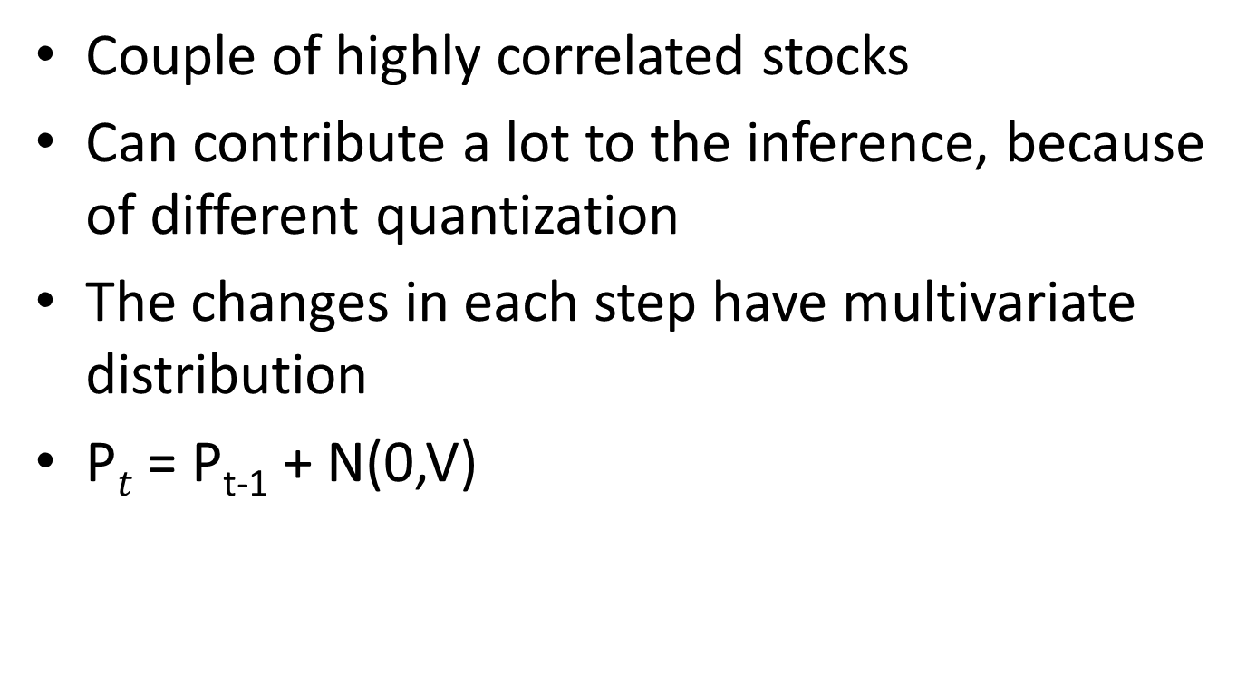
More than one stock
Couple of highly correlated stocks
Can contribute a lot to the inference, because of different quantization
The changes in each step have multivariate distribution
P$t$ = P_{t-1} + N(0,V)

Slide 19

Sample stock prices’
Two stocks for simplicity
D$t$, P$t$ , S_{i} are vectors with two component
Need to sample from P(P$t$ , D$t$| P_{t-1} = S_{i})
P(Pt ,Dt | Pt-1 = Si) = P(D_{t,1},P_{t,1}| P_{t-1} = S_{i})P(D_{t,2},P_{t,2}| P_{t-1} = S_{i,}P_{t1},D_{t1})

Slide 20
Sample stock prices’
First sample P_{t,1} from P(D_{t,1},P_{t,1}| P_{t-1} = Si)
P(D_{t,1},P_{t,1}| P_{t-1} = S_{i}) = P(D_{t,1},P_{t,1}| P_{t-1,1} = S_{i ,1})
Exactly as before, sample P_{t,1} with weight w1
Now we have P(D_{t,2},P_{t,2}| P_{t-1} = S_{i,}P_{t1},D_{t1}) = P(D_{t,2},P_{t,2}| P_{t-1,2} = S_{i ,2} ,|P_{t,1-}P_{t,1,1}| = d)
Now P_{t,2} –P_{t-1,2} is still normal , but the distribution is a*d(according to the multivariate distribution), and the variance is smaller.

Slide 21
Sample stock prices’
Sample P_{t,2} exactly as before, but with different mean and variance, and with weight w₂
Creating sample(P_{t,1},P_{t,2}), with weight w₂w₁

